Slide 1
Software Evaluation and Costing
Subhash Paudel
MSCSKE, IOE, Pulchowk Campus
subhash@achsnepal.edu.np
Notes:
M.Sc. Computer Engineering, Computer System and Knowledge Engineering

Slide 2
Project Evaluation
A high level assessment of the project
to see whether it is worthwhile to proceed with the project
to see whether the project will fit in the strategic planning of the whole organization
Project Evaluation →Gives answers to → 1. whether a project is worth undertaking or not 2. what factors are important in selecting or rejecting a project proposal before project is started

Slide 3
Project Evaluation
At the project level, evaluation involves processes→
Discussing a viable evaluation plan with stakeholders;
Designing and planning the evaluation;
collecting, identifying and analyzing information and evidence;
Distributing the findings to describe or understand the project and/or to make project related decisions.

Slide 4
Project Evaluation
Always perform 5W1H/W5H questions and its answers
Why?
What?
When?
Who?
Where?
How?

Slide 5
5W1H/W5H Principle
Why is the system being develop?
Answer to this questions help assess validity of business reason for the software work.
It answers if the business purpose justifies the expenditure of people, time and money
What will be done?
Answer to this question establishes the task set required for project
When will it be done?
Answer to this question helps the team establish a project schedule by identifying when tasks have to be conducted and when milestones are to be reached

Slide 6
5W1H/W5H Principle
Who is responsible for a function ?
Answer to this question establishes roles and responsibility of each team member
Where are they organizationally located ?
Answer to this question indicates that all roles and responsibilities are not limited to the software team itself, the customers, users and stakeholders also have responsibilities.
How will be job done technically and managerially ?
Once product scope is establishes, a technical and management strategy must be defined for it.
How much of each resource is needed ?
Answer to this question is derived by developing estimates based on answers to earlier questions.

Slide 7
Project Evaluation
What is Project Evaluation ??
A high level assessment of the project to see whether it is worthwhile to proceed with the project
to see whether the project will fit in the strategic planning of the whole organization
Why Project Evaluation ??
Want to decide whether a project can proceed before it is too late
Want to decide which of the several alternative projects has a better success rate, a higher turnover, a higher rate of return
Given three projects A,B,C → not all projects can be taken by a particular organization , need to choose one among three, how and by what criteria??
Is it desirable to carry out the development and operation of the software system

Slide 8
Project Evaluation
Who is Responsible for Project Evaluation
Senior management
Project manager/coordinator
Team leader
When is project evaluation done?
Usually at the beginning of the project e.g. Step 0 of Step Wise Framework
Notes:
Where ???
HOW ???

Slide 9
Project Portfolio Management
Any organization has limited resource and it is in its best interest to select a project that’s matches the organization’s goal and mission for the greater good and benefit of it and towards the society
Google favors a search engine project while cisco prefers internet and hardware related projects → Why????
Notes:
identifying which project proposals are worth implementation;
assessing the amount of risk of failure that a potential project has;
deciding how to share limited resources, including staff time and finance, between projects – one problem can be that too many projects are started given the resources available so that inevitably some projects will miss planned completion dates;
being aware of the dependencies between projects, especially where several projects need to be completed for an organization to reap benefits;
ensuring that projects do not duplicate work;
ensuring that necessary developments have not been inadvertently been missed.

Slide 10
Project Portfolio Management (contd.)
Portfolio project management provides an overview of all the projects that an organization is undertaking or is considering.
Why → It prioritizes the allocation of resources to projects and decides which new projects should be accepted and which existing ones should be dropped. (Project evaluation and its deciding criteria)
The concerns of project portfolio management include:
identifying which project proposals are worth implementation;
assessing the amount of risk of failure that a potential project has;
deciding how to share limited resources, including staff time and finance, between projects – one problem can be that too many projects are started given the resources available so that inevitably some projects will miss planned completion dates;
being aware of the dependencies between projects, especially where several projects need to be completed for an organization to reap benefits;
ensuring that projects do not duplicate work;
ensuring that necessary developments have not been inadvertently been missed.

Slide 11
Project Evaluation
What Assessment are performed for project evaluation / accepting or rejecting a project ?
Strategic assessment
Technical assessment
Economic assessment
How project evaluation (Economic and risk Assessments) are performed?
Cost-benefit analysis
Cash flow forecasting
Cost-benefit evaluation techniques
Risk analysis

Slide 12
Strategic Assessment
Used to assess whether a project fits in the long-term goal of the organization
Usually carried out by senior management
Needs a strategic plan that clearly defines the objectives of the organization
Evaluates individual projects against the strategic plan or the overall business objectives Programme management
For example →
What projects do facebook prefer vs google and why???
What projects do e-sewa prefer vs fusemachines and why???
suitable for projects developed for use in the organization Portfolio management
suitable for project developed for other companies by software houses

Slide 13
Technical assessment
In this assessment a project is selected based on whether the organization has sufficient hardware and software resources for that particular project???
Note: resources not only means materials, they also mean people associated with it , experts etc
Technical assessment of a proposed system consists of evaluating whether the required project functionality can be achieved with current affordable technologies of an organization????.
Organizational policy, aimed at providing a consistent hardware/software infrastructure, is likely to limit the technical solutions considered.
The costs of the technology adopted must be taken into account in the cost–benefit analysis. →
i.e. When technical assessment is done need to ask → if the organization takes a particular project then would the organization’s available technology or newly bought technology benefit the company or will drive to loss or neither profit nor loss???

Slide 14
Cost–benefit analysis
Your IT company has offer for 5 projects where the estimated benefits will exceed the estimated costs
Answer the following:
Will you take all of them?
Some of them or just one of them
And what matters in choosing those projects????
Decide if the proposed project is the best of several options because not all projects can be undertaken at any one time (why you can’t take all of them???)
and, in any case, the most valuable projects should get most resources.

Slide 15
Cost–benefit analysis comprises two steps:
Step 1 . It means identifying all of the costs and benefits of carrying out the project and operating the delivered application. These include :
Development costs,
the operating costs
and the benefits expected from the new system
Direct benefits
Assessable indirect benefits
Intangible benefits
Note → imagine yourself as a project manager and think in such cases for project acceptance or refusal when you have 5 projects and which two of them would you chose and how do you allocate resources for them. Discuss ???

Slide 16
Cost–benefit analysis comprises two steps: (contd.)
Step 2.
Express these costs and benefits in common units.
must express each cost, benefit in terms of money – and the net benefit as difference of the two
Net benefit = Total benefit - Total cost
Most direct costs can be categorized as:
development costs including development staff costs;
setup costs consisting of the costs of putting the system into place, mainly of any new hardware but also including the costs of file conversion, recruitment and staff training;
operational costs relating to operating the system after installation.

Slide 17
Cost–benefit analysis comprises two steps: (contd.)
Benefits can be categorized as:
Direct Benefits it is directly obtained by making use of/operating the system.
Cost savings (e.g., less staff, less paper, quicker turnaround)
Money generation (e.g., new revenue stream, new markets)
Assessable indirect benefits these benefits are obtained due to updating / upgrading the performance of current system. It is also referred as “secondary benefits”.
Intangible benefits these benefits are longer term, difficult to quantify. It is also referred as “indirect benefits”. Example: enhanced job interest leads reduction of staff turnover, in turn leads lower recruitment costs

Slide 18
Cash Flow Forecast
cash flow forecast indicates when expenditure and income will take place. Its equally important as cost benefit analysis
Why the timing factor is important in cash flow forecast ??
Cash flow considerations
Is initial funding for the project available?
Is timing of incoming/outgoing cash flow in line with financial plans?
If cash flow is critical, forecasting should be done quarterly or monthly
Project managers need to know that development expenditure must either be from the company’s own resources or by borrowing.
A forecast is needed of when expenditure (such as the payment of salaries) and any income are to be expected.

Slide 19
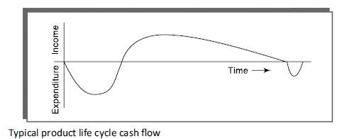
Cash Flow Forecast (Contd.)
Observe during the project’s lifecycle and the final outcome and think at which stage are there positive and negative cash flows
Typically products generate a outgoing payments/ negative cash flow during their development followed by a positive cash flow/ incoming payments over their operating life.
There might be additional costs at the end of the project life

Slide 20
Cash Flow Forecast (Contd.)
need to spend money in staff wages, during a project’s development . Such expenditure cannot wait until income is received (either from using software developed in-house use or from selling it).
A forecast is needed of when expenditure(such as the payment of salaries) and any income are to be expected.
Accurate forecast is not easy because
it is done early in the project’s life cycle (at least before any significant expenditure is committed)
and many items to be estimated (particularly the benefits of using software) might be some years in the future.
Need to revise the forecast from time to time

Slide 21
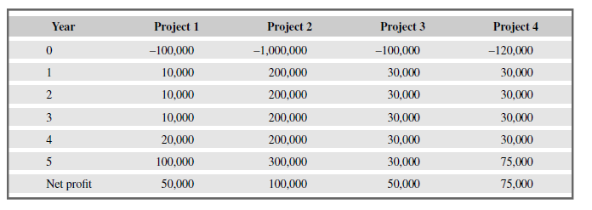
Cost Benefit Evaluation techniques
Cost benefit Evaluation mainly consider
The timing of the costs and benefits
The benefits relative to the size of the investment
Four project cash flow projections – figures are end of year totals
Consider the above project cash flow estimates for four projects
Negative values represent expenditure and positive values income.
Rank the four projects in order of financial desirability and make a note of your reasons.

Slide 22
Cost Benefit Evaluation techniques
Evaluation techniques for comparing projects on the basis of their cash flow forecasts are:
Net Profit
Pay Back period
ROI
NPV
IRR

Slide 23
1. Net Profit
Difference between total cost and total income
Cash flows take place at the end of each year.
The year 0 represents the initial investment made at the start of the project.
Also called Net income or net earnings
Net profit=total costs-total incomes
Pros:
Easy to calculate

Slide 24
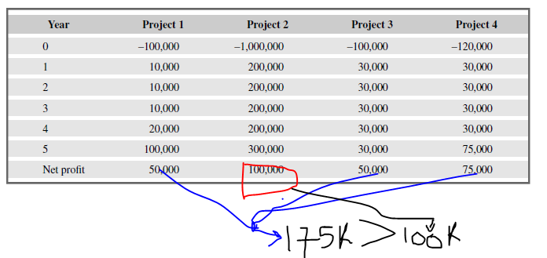
Cons:
Does not show profit relative to size investment (e.g., consider Project 2)
Does not consider timing of payments (e.g., compare Projects 1 and 3) Not very useful other than for "back of envelope" evaluations
Project 2 shows the greatest net profit but this is at the expense of a large investment.
Indeed, if we had £1 m to invest, we might undertake all of the other three projects and obtain an even greater net profit.
Note also that all projects contain an element of risk and we might not be prepared to risk £1 m. So Project 2 is not our 1st choice

Slide 25
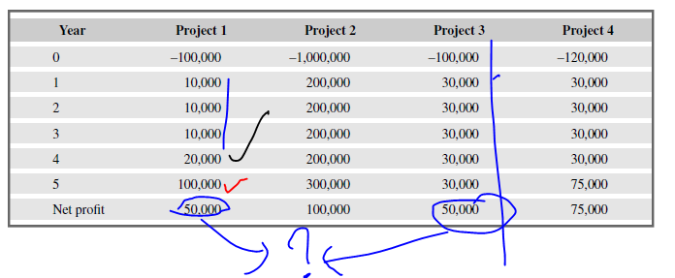
Net Profit Analysis of projects 1 vs 3
Projects 1 and 3 each have a net profit of £50,000 and therefore, according to this selection criterion, would be equally preferable.
But the bulk of the income occurs late in the life of project 1, whereas project 3 returns a steady income throughout its life.
Having to wait for a return has the disadvantage that the investment must be funded for longer.
Add to that the fact that, other things being equal, estimates in the more distant future are less reliable than short-term estimates
and we can see that the two projects are not equally preferable.
Hence we choose Project 3 over 1 and ranking is 3>1>4>2

Slide 26
2. Payback Period
The payback period is the time taken to recover the initial investment.
It is the length of time required for cumulative incoming returns to equal the cumulative costs of an investment
The payback period is expressed in years and fractions of years
if investment $300,000 , and cash flow of $100,000 per year, then the payback period is 3.0 years
Normally, the project with the shortest payback period will be chosen

Slide 27
Payback Period

Slide 28
Payback Period
Project1 =10,000+10,000+10,000+20,000+1, 00,000=1, 50,000
Project 2= 2,00,000+2,00,000+2,00,000+2,00,000+3,00,000=11,000,00
Project 3= 30,000+30,000+30,000+30,000 + 75,000 =1,95,000
Average Net profit for project 1 per year is 30,000
Average Net profit for project 2 per year is 2,20,000
Average Net profit for project 3 per year is 39,000
Pay Back Period:
Project 1: 1,00,000/30,000 =3.33 yrs.
Project 2: 10,00,000/2,20,000=4.5 yrs
Project 3: 1,20,000/39,000= 3.07 yrs.

Slide 29
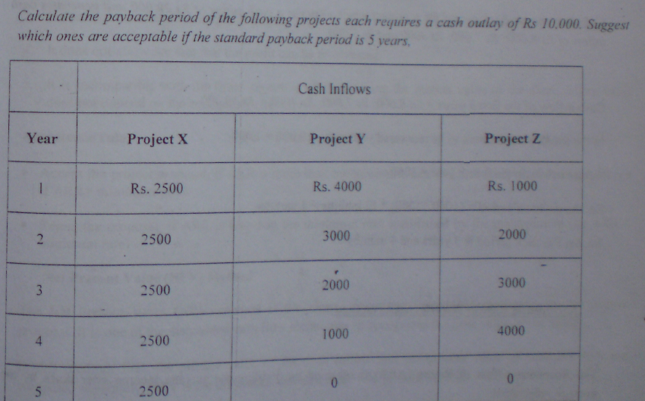
Qns type 1 – equal cash inflow over the years

Slide 30
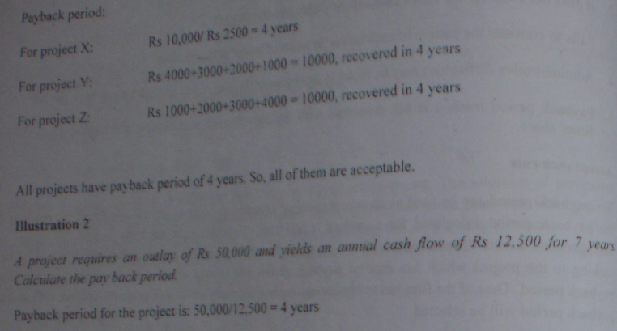
Soln - equal cash inflow over the years

Slide 31
Imp such qns →Qns type 2 – when cash inflow are unequal and the added value don’t match the outflow /outlay sum over the exact years
Calculate the payback period for a project which require a cash outlay of 20k and generate the cash inflow of 8k, 7k, 4k and 3k
Solution
Cash inflow for the first 3 years = 8k+7k+4k=19k
In the fourth year amount need to recover =20k-19k =1 k
Actual cash inflow in the fourth year =3 k
so payback period = 3 years + (1k /3k) * 12 months = 3 years 4 months

Slide 32
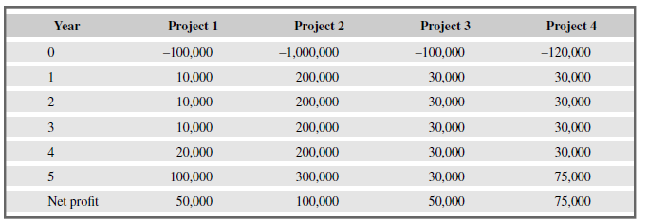
Exercise →Consider the four project cash flows given in Table and calculate the payback period for each of them and rank them according to payback periods
the cash flows take place at the end of each year.

Slide 33
Answer
The payback periods for each of the projects will occur during the year indicated:
project 1, 4 year 6 months;
project 2, 4 year 8 months;
project 3, 3 year 4 months
and project 4, 4 years.
We would therefore favour project 3 over the other three.

Slide 34
Payback Period Advantage and disadvantage
Advantage → simple to calculate and is not particularly sensitive to small forecasting errors.
Disadvantage →ignores the overall profitability of the project – in fact, it totally ignores any income (or expenditure) once the project has broken even.
Thus the fact that projects 2 and 4 are, overall, more profitable than project 3 is ignored. See the table for this reasoning and analysis

Slide 35
Payback Period
Project Selection Rule: Payback period is less than the maximum payback period set up by the management select the project
Pros:
simple and easy to calculate.
It is also a seriously flawed method of evaluating investments
Cons:
It attaches no value to cash flows after the end of the payback period.
It makes no adjustments for risk.
It is not directly related to wealth maximization
It ignores the time value of money.
The "cut off" period is arbitrary.
It ignores any benefits that occur after the payback period and, therefore, does not measure profitability.

Slide 36

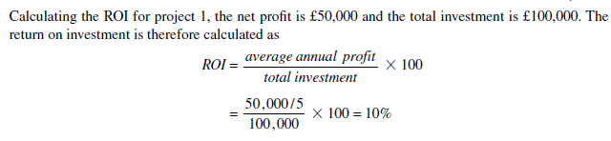
3. Return on investment(ROI)/Accounting rate of return (ARR)
provides a way of comparing the net profitability to the investment required
A performance measure used to evaluate the efficiency of an investment
Project with highest ROI is selected or preferred

Slide 37
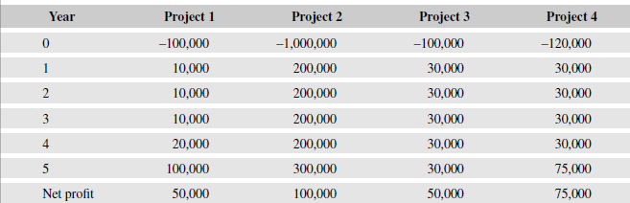
Calculate the ROI for each of the other projects shown in Table and decide which, on the basis of this criterion, is the most worthwhile.
The return on investments for each of the projects is – project 1: 10%, project 2: 2%, project 3: 10% and project 4: 12.5%.
Project 4 therefore stands out as being the most beneficial as it earns the highest return.
4>3>1>2

Slide 38
ROI/ARR Advantages and Disadvantages
Pros → The return on investment provides a simple, easy-to-calculate measure of return on capital.
Cons → it suffers from two severe disadvantages.
Like the net profitability, it takes no account of the timing of the cash flows.
More importantly, this rate of return bears no relationship to the interest rates offered or charged by banks (or any other normal interest rate) since it takes no account of the timing of the cash flows or of the compounding of interest.
It is therefore, potentially, very misleading.

Slide 39
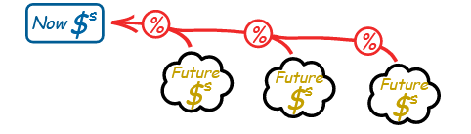
4. Net present value
Net present value (NPV) analysis is a method of calculating the expected net monetary gain or loss from a project by discounting all expected future cash inflows and outflows to the present point in time. It allows you to calculate an accurate value for the project in today’s price.
A project evaluation technique that takes into account the profitability of a project and the timing of the cash flows that are produced
Sum of all incoming and outgoing payments, discounted using an interest rate, to a fixed point in time (the present)
Money now is more valuable than money later on.

Slide 40


NPV
Let us say you can get 10% interest on your money.
So $1,000 now could earn $1,000 x 10% = $100 in a year. Your $1,000 now would become $1,100 by next year.
So $1,100 next year is the same as $1,000 now.
So We say the Present Value of $1,100 next year is $1,000

Slide 41
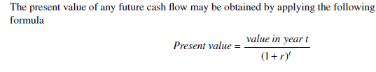
NPV
where r is the discount rate, expressed as a decimal value, and t is the number of years into the future that the cash flow occurs.
The NPV for a project is obtained by :
discounting each cash flow (both negative and positive)
and summing the discounted values.
Net Present Value (NPV) is the difference between the present value of cash inflows and the present value of cash outflows.
It is normally assumed that any initial investment takes place immediately (indicated as year 0) and is not discounted.
Later cash flows are normally assumed to take place at the end of each year and are discounted by the appropriate amount.

Slide 42
Net present value→ £ 100 now or £ 100 after a year Which would you choose and why??
Receiving £100 today is better than having to wait until next year to receive it.
We could, for example, invest the £100 in a bank today and have £100 plus the interest in a year’s time.
If we say that the present value of £100 in a year’s time is £91, we mean that £100 in a year’s time is the equivalent of £91 now.
The equivalence of £91 now and £100 in a year’s time means we are discounting the future income by approximately 10%. (a good example of NPV)
If we received £91 now and invested it for a year at an annual interest rate of 10%, it would be worth £100 in a year’s time.
The annual rate by which we discount future earnings is known as the discount rate – 10% in the above example.
Similarly, £100 received in two years’ time would have a present value of approximately
£83 – in other words, £83 invested at an interest rate of 10% would yield approximately £100 in two years’ time.

Slide 43
Projects with +ve NPV are to be accepted or higher NPV value are to be chosen
An organization should consider only projects with a positive NPV → if financial value is a key criterion for project selection.
This is because a positive NPV means the return from a project exceeds the cost of capital(the return available by investing the capital elsewhere)
Projects with higher NPVs are preferred to projects with lower NPVs, if all other factors are equal

Slide 44
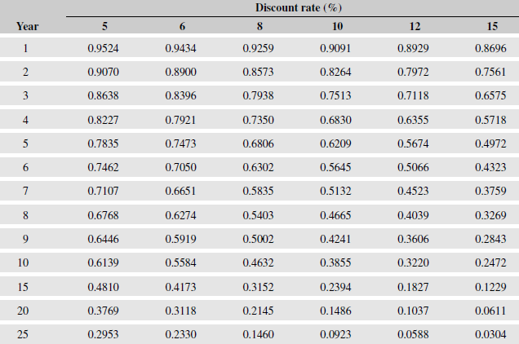
Alternative way of NPV calculation
Alternatively, and rather more easily, the present value of a cash flow may be calculated by multiplying the cash flow by the appropriate discount factor.
A small table of discount factors is given in Table below

Slide 45
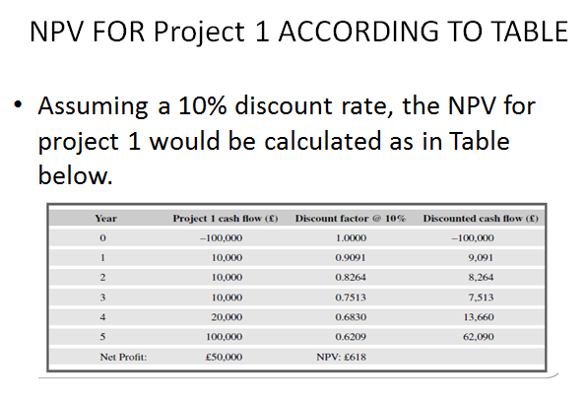

Slide 46
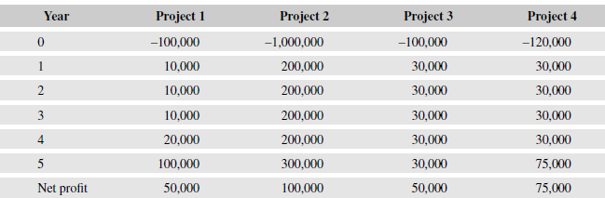
Using a 10% discount rate, calculate the net present values for projects 2, 3 and 4 and decide which, on the basis of this, is the most beneficial to pursue.

Slide 47
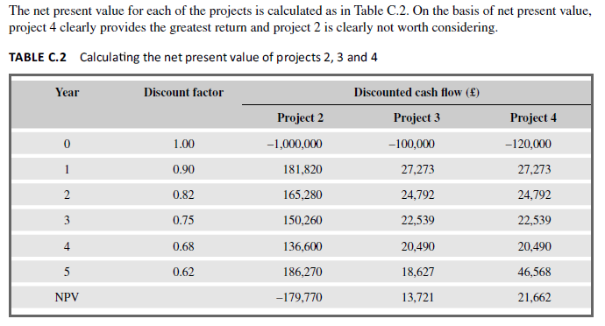
It is interesting to note that the net present values for projects 1 and 3 are significantly different – even though they both yield the same net profit and both have the same return on investment.
The difference in NPV reflects the fact that, with project 1, we must wait longer for the bulk of the income.

Slide 48
NPV
The main difficulty with NPV for deciding between projects is selecting an appropriate discount rate.
Some organizations have a standard rate but, where this is not the case, then the discount rate should be chosen to reflect available interest rates (borrowing costs where the project must be funded from loans) plus some premium to reflect the fact that software projects are normally more risky than lending money to a bank.
The exact discount rate is normally less important than ensuring that the same discount rate is used for all projects being compared.
However, it is important to check that the ranking of projects is not sensitive to small changes in the discount rate

Slide 49
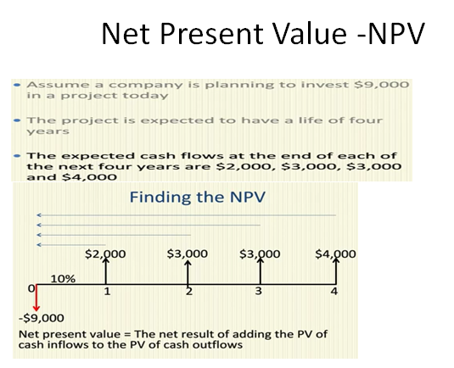
NPV
Assume a company is planning to invest $90000 in a project today
The project is expected to have a life of four years
The expected cash flows at the end of each of next four years are $2000, $3000, $3000, $4000

Slide 50
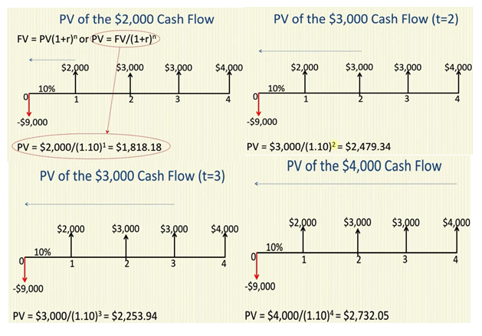

Slide 51
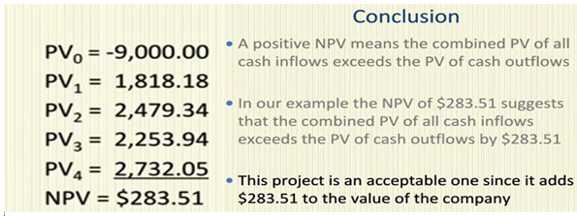
Adding all cash inflow (+ve value ) and outflow (-ve value )of each year including the capital

Slide 52
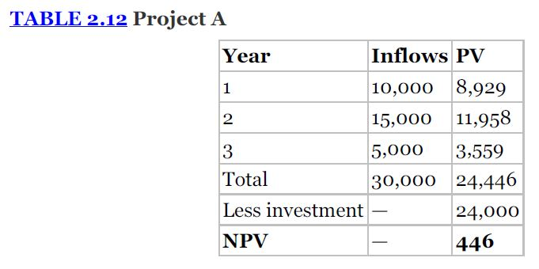
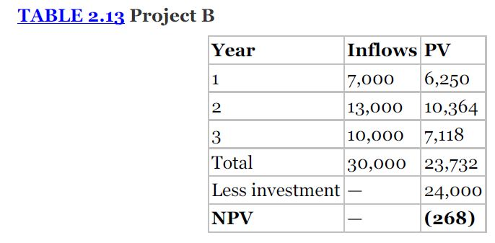
NPV Another example
Project A and B both has capital investment of 24000 and has 12% rate on capital in 3 sequential years. But the cash inflow of each project at the end of each year is different given in the following table.
Which would you choose????
NPV- choose project A vs B which one??

Slide 53
NPV- choose project A vs B which one??
FV = PV(1 + i)^n or
PV = FV / (1 + i)^n
Here Proj A investment is 24000 and the total PV = 24,446 so 24446 (PV ) >24000(capital) = +ve Npv

Slide 54
NPV Cntd..
Proj B investment 24000
Here Proj B investment is 24000 and the total PV = 23372 so
23372 (PV ) < 24000(capital) = - ve Npv
Since Project A has an NPV greater than 0 and should be accepted.
Project B has an NPV less than 0 and should be rejected.

Slide 55
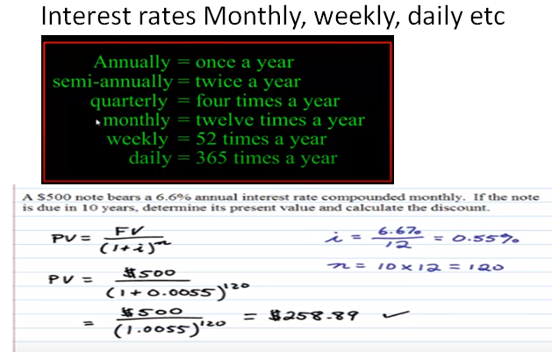
Beware Of interest rate unit in qns

Slide 56
Internal rate of return (IRR)
It is the discount rate that would produce an NPV of 0 for the project
Can be used to compare different investment opportunities
The higher the IRR the better
Pros: Calculates figure which is easily comparable to interest rates
Cons: Difficult to calculate (iterative)
Standard way to compare projects

Slide 57
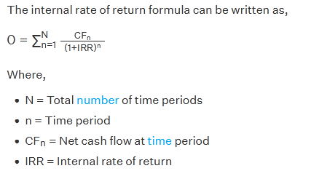
IRR
There are certain rules to keep in mind while calculating the internal rate of return formula. They are:
Set the NPV to zero and solve for the discount rate i.e. the internal rate of return
The initial investment is always negative because it represents an outflow
Each subsequent cash flow could be positive or negative, depending on the estimated cash flow determined by the project in the future
IRR cannot be easily calculated analytically instead use a more technical method like excel

Slide 58
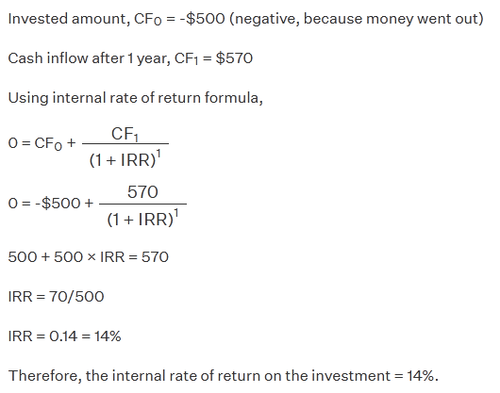
An investor made an investment of $500 and got $570 next year. Calculate the internal rate of return on the investment

Slide 59
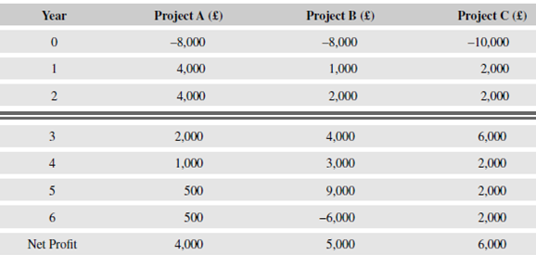
Check if the projects A, B, and C shown in Table are worth taking up when the rate of interest on borrowed capital is 15%.
By using discount rate of 15%, the NPV of the three projects work out to be 852, 607, and 197, respectively.
Therefore, all the three projects are worth taking up when the rate of interest on borrowed capital is 15%.

Slide 60
Disadvantages IRR
IRR does not indicate the absolute size of the return. i.e. A project with an NPV of £100,000 and an IRR of 15% can be more attractive than one with an NPV of £10,000 and an IRR of 18% – the return on capital is lower but the net benefits greater.
Under certain conditions, it is possible to find more than one rate that will produce a zero NPV. However, if there are multiple solutions, it is always appropriate to take the lowest value and ignore the others.

